Slide 1
Critical Micelle Concentrations of Surfactant Blends Which Form
Viscoelastic Solutions
AmirHosein Valiollahzadeh
Jose Lopez Salinas
Maura Puerto

Slide 2
Objective
Set up and confirm operation of donated instrument from ExxonMobil for measuring CMC. Measure CMC of solutions which become viscoelastic at higher concentrations and generate strong foams in porous media.
Background
As shown in a previous presentation, there is a zwitterionic-anionic (Z-A) blend that formed visco-elastic solutions in the presence of divalent ions. It also was tested in a sand pack and produced strong foams with apparent viscosities at 94°C.

Slide 3
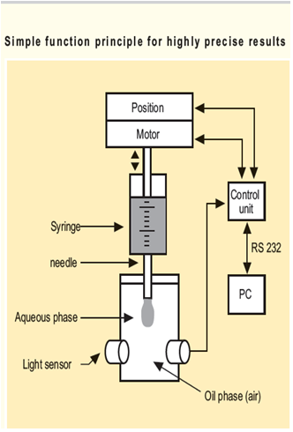
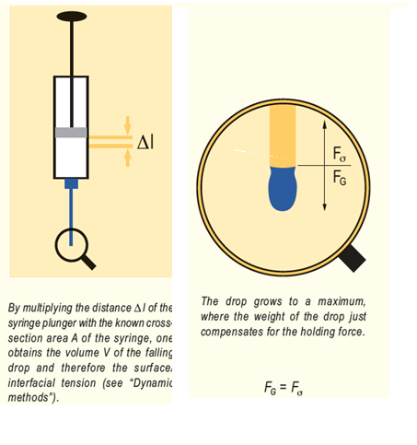
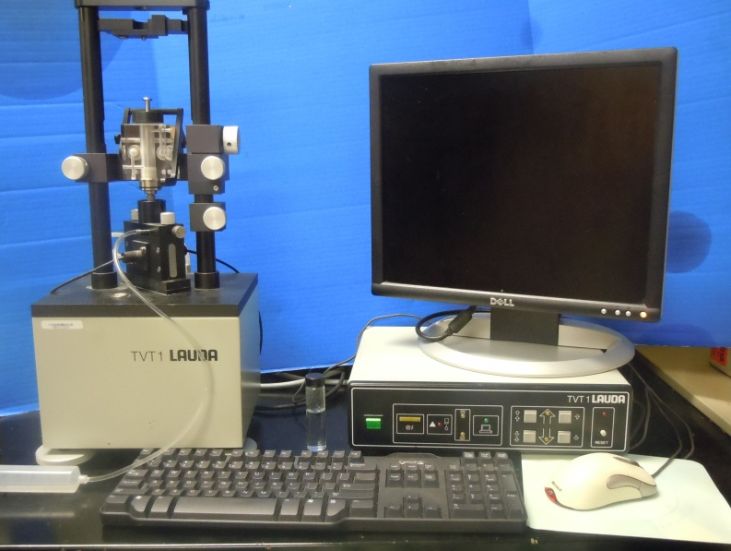
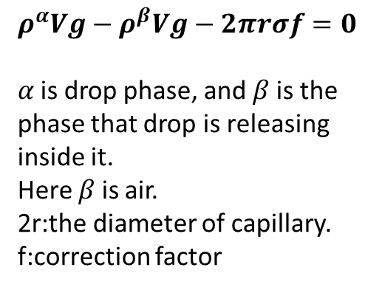

Drop Volume Apparatus for Measuring
Surface Tension vs. Concentration and CMC
$$Weight−Buoyancy−capilary for=0$$
$ρ^{α}Vg−ρ^{β}Vg−2πrσf=0$
$α$is drop phase, and $β$ is the phase that drop is releasing inside it.
Here $β$ is air.
2r:the diameter of capillary.
f:correction factor

Slide 4
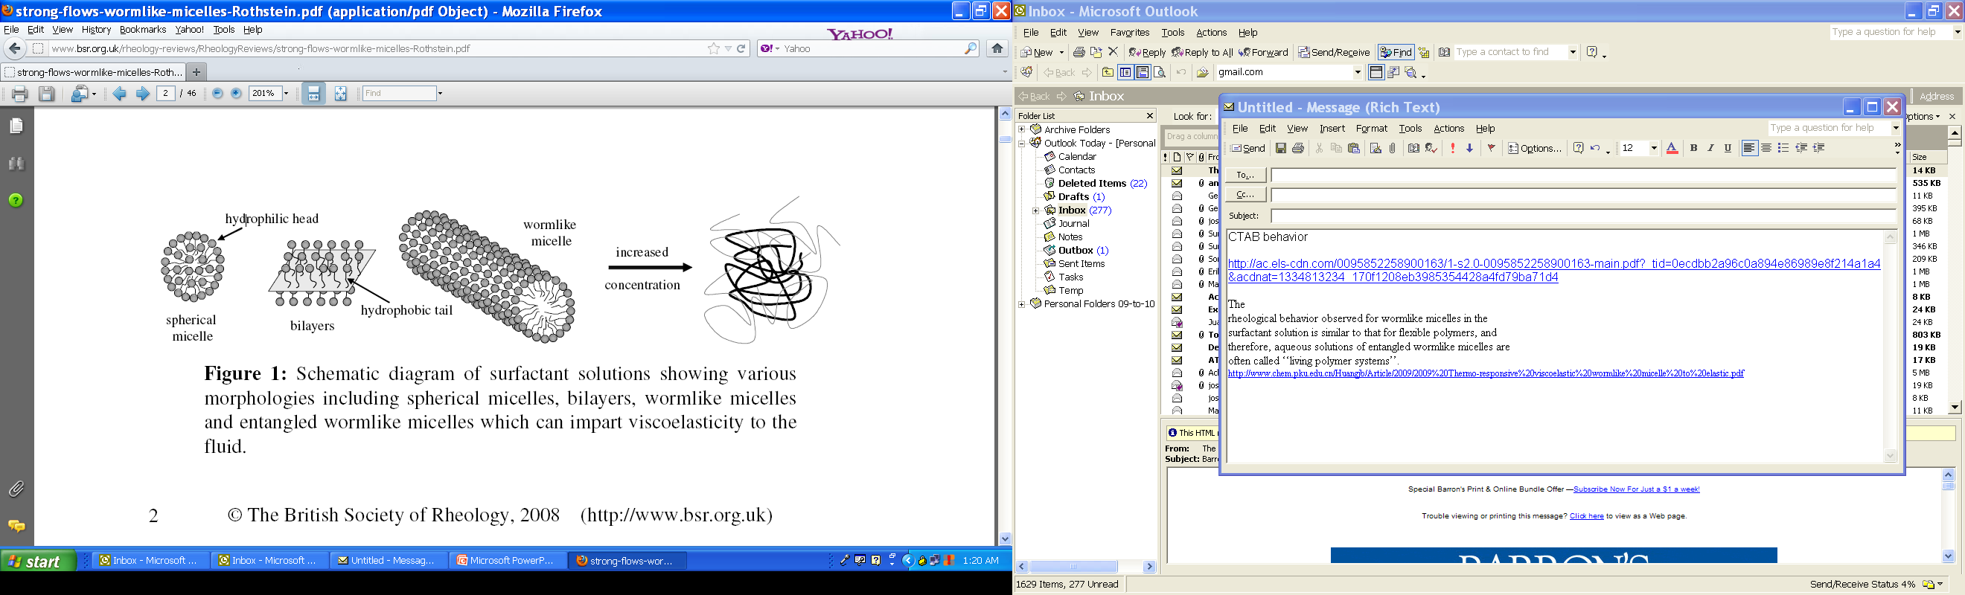
Transitions from Spherical Micelles
to Viscoelastic Solution
Entangled wormlike micelles impart viscoelasticity
Critical Worm Micelle Concen-
tration: micelles start to elongate
The British Society of Rheology, 2008 (http://2 www.bsr.org.uk) J. P. Rothstein, Rheology Reviews 2008, 1 - 46. http://stratingh.eldoc.ub.rug.nl/FILES/root/1998/JCollIntfSciBijma/1998JColloidInterfaceSciBijma.PDF

Slide 5
Strategies and Test Plan
One objective is to achieve viscoelastic solutions which form strong foams at low surfactant concentrations. For this purpose it is desirable to form viscoelastic solutions at concentrations not far above the CMC.
Measure CMCs for selected blends of A, Z, C in DIW, sea water with divalent cations (SW), and NaCl solution with same ionic strength as sea water (SWIS).
Conduct rheology measurements at concentrations above CMC to determine when viscoelastic behavior first appears (in progress).

Slide 8
Summary Of Test Results
Surfactant | CMC, mM |  |  | IFT, dynes/cm
 | DI Water | NaCl =SWis | SeaWater | DI Water | NaCl =SWis | SeaWater
2:1:0 Z:A:C | 0.9 | 0.8 | 0.5* | 29 | 28 | 26
4:2:1 Z:A:C | 0.6 | 0.7 | 0.7 | 28 | 28 | 28
* Viscoelastic solution at 1% weight concentration
Hardness produces decrease in both CMC and IFT at CMC
for 2:1 ZA blend
ZAC blend is insensitive to salinity and hardness

Slide 9
Rheological Behavior of 1% ZA blend in DI Water
ZA –failed to show viscoelasticity
G’ and G’’ and phase angle for the Surfactant solution(ZA) in DI water

Slide 10
Rheological Behavior of 1% ZA blend in NaCl (SWIS)
It is more viscous than elastic in NaCl brine

Slide 11
Rheological Behavior of 1% ZA blend in SeaWater
It becomes dominant elastic at high frequencies in SW

Slide 12
Remarks
Both blends insensitive to NaCl content. Hardness lowers CMC and produces viscoelasticity for ZAblend but not ZAC blend.
Future Work
Measure rheological behavior, of system selected from phase behavior test at reservoir conditions, from CMC to higher concentration
Investigate effect of
    Salinity
    Surfactant ratios in blends

Slide 13
END

